Slide 1

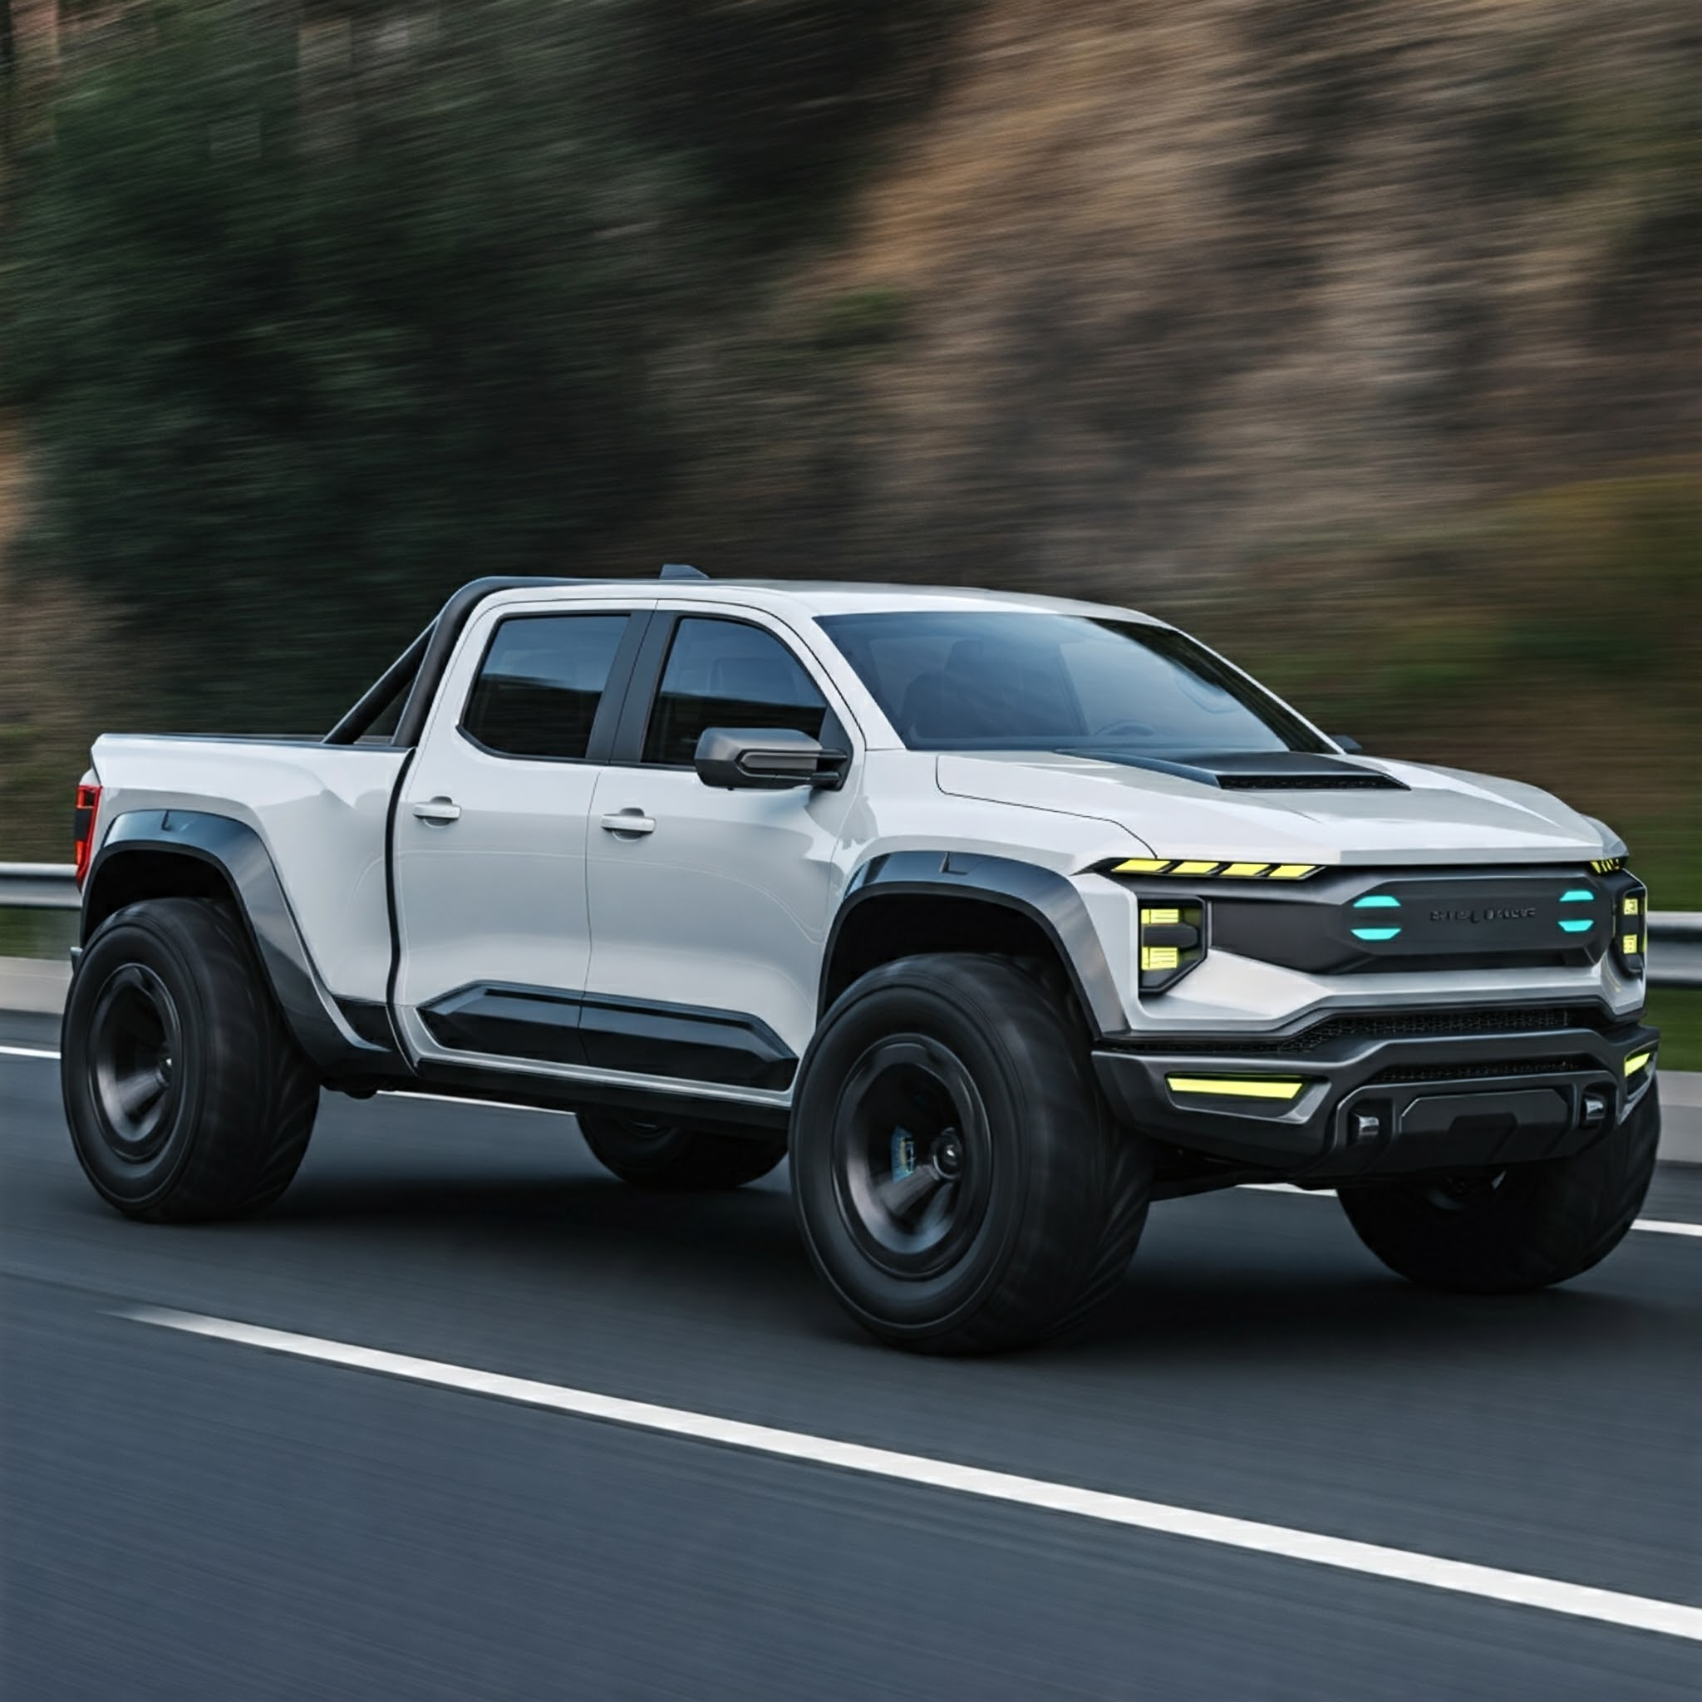
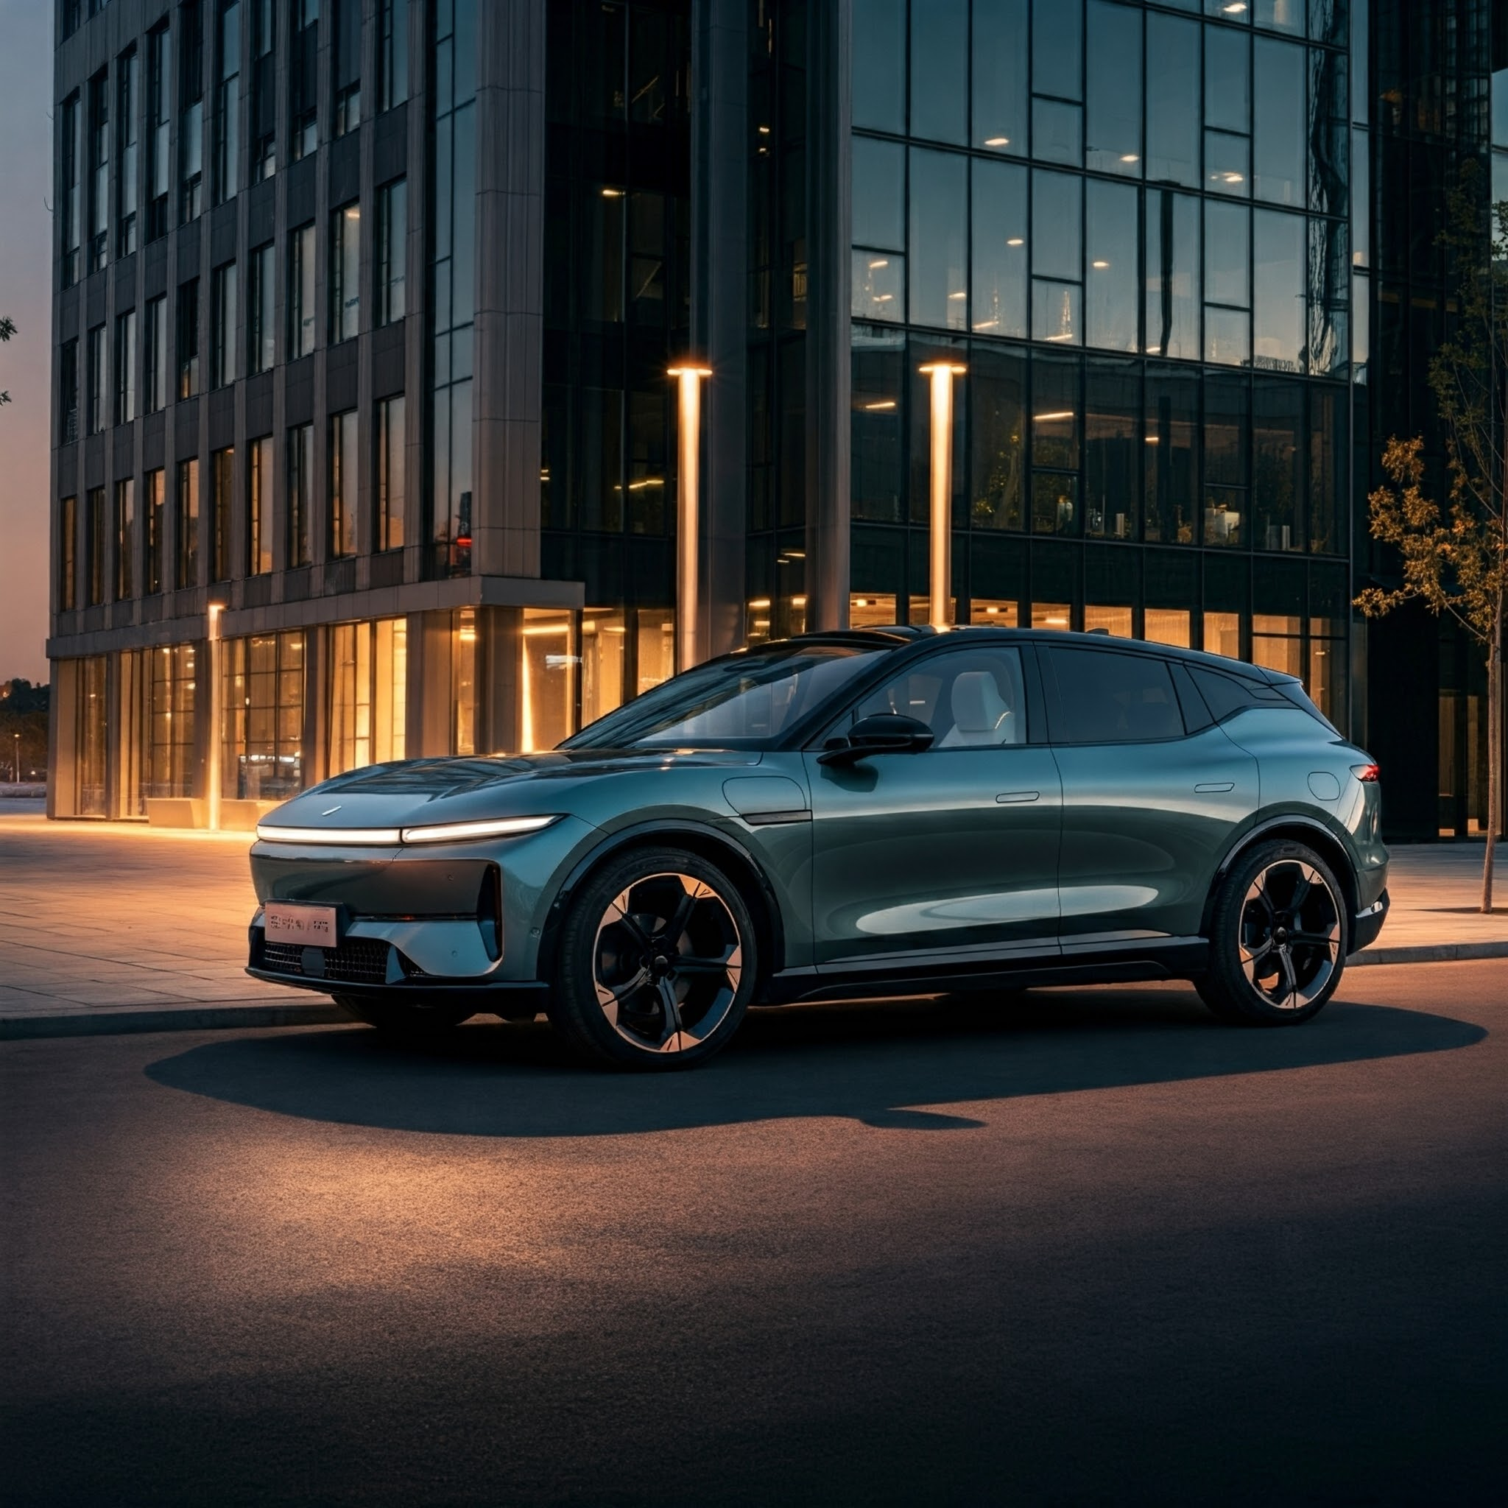
Home Page
Input user info
Sign Up
User Info
Logo
Home | About Us | Contact
Navigation
Separate Anchor Panes in a Split Pane
Titanium Commander
NovaFlux Aurora
Learn More…
Learn More…
Buttons to open more info

Slide 2
TruckPage
Sign Up
User Info
Home | About Us | Contact
Titanium Commander
Renew button only works if age over 21. Shows text to confirm below it after clicking
Seating: 5
Mile Range: 800 miles
Make: Titanium
Model: Commander
Year: 3000
Top Speed: 140 mph
Towing Capacity: 6900 lbs
Rental Price: $1000/day
Reserve
Car Image, Name, & Info

Slide 3
TruckPage
Sign Up
User Info
Home | About Us | Contact
Titanium Commander
Seating: 5
Mile Range: 800 miles
Make: Titanium
Model: Commander
Year: 3000
Top Speed: 140 mph
Towing Capacity: 6900 lbs
Rental Price: $1000/day
Reserve
Sign up to reserve Titanium Commander.
When button pressed if not signed in.

Slide 4
TruckPage
Sign Up
User Info
Home | About Us | Contact
Titanium Commander
Seating: 5
Mile Range: 800 miles
Make: Titanium
Model: Commander
Year: 3000
Top Speed: 140 mph
Towing Capacity: 6900 lbs
Rental Price: $1000/day
Reserve
You must be 21 or older to reserve.
When button pressed if under age 21.

Slide 5
TruckPage
Sign Up
User Info
Home | About Us | Contact
Titanium Commander
Seating: 5
Mile Range: 800 miles
Make: Titanium
Model: Commander
Year: 3000
Top Speed: 140 mph
Towing Capacity: 6900 lbs
Rental Price: $1000/day
Reserve
Thank you for reserving! Please come in to our location found in the “Contact” tab within the next week to pickup
When button pressed if successful.

Slide 6
TruckPage
Sign Up
User Info
Home | About Us | Contact
NovaFlux Aurora
Seating: 8
Mile Range: 600 miles
Make: NovaFlux
Model: Aurora
Year: 2999
Top Speed: 169 mph
Trunk Space: 50 cubic feet
Charge Time: 30 mins
Rental Price: $1200/day
Renew button only works if age over 21. Shows text to confirm below it after clicking
Reserve
Car Image, Name, & Info

Slide 7
TruckPage
Sign Up
User Info
Home | About Us | Contact
NovaFlux Aurora
Seating: 8
Mile Range: 600 miles
Make: NovaFlux
Model: Aurora
Year: 2999
Top Speed: 169 mph
Trunk Space: 50 cubic feet
Charge Time: 30 mins
Rental Price: $1200/day
Reserve
Sign up to reserve Titanium Commander.
When button pressed if not signed in.

Slide 8
TruckPage
Sign Up
User Info
Home | About Us | Contact
NovaFlux Aurora
Seating: 8
Mile Range: 600 miles
Make: NovaFlux
Model: Aurora
Year: 2999
Top Speed: 169 mph
Trunk Space: 50 cubic feet
Charge Time: 30 mins
Rental Price: $1200/day
Reserve
You must be 21 or older to reserve.
When button pressed if under age 21.

Slide 9
TruckPage
Sign Up
User Info
Home | About Us | Contact
NovaFlux Aurora
Seating: 8
Mile Range: 600 miles
Make: NovaFlux
Model: Aurora
Year: 2999
Top Speed: 169 mph
Trunk Space: 50 cubic feet
Charge Time: 30 mins
Rental Price: $1200/day
Reserve
Thank you for reserving! Please come in to our location found in the “Contact” tab within the next week to pickup
When button pressed if successful.

Slide 10
Sign Up / Change Info Page
Sign Up
User Info
Home | About Us | Contact
Title and navigation button text will update to “Change User Information” after signed up.
Sign Up
First Name:
Last Name:
Email Address:
Driver’s License #:
Date of Birth:
Insert First Name
Inputting *VALID* info in the text fields updates the “User Info” section.
Insert Last Name
Insert Email Address
Insert Driver’s License #
Negative values and values outside of the ranges entered for DOB will be cleared and you will be prompted to redo them.
YEAR (YYYY)
MONTH (MM)
DAY (DD)

Slide 11
User Info Page
Sign Up
User Info
Home | About Us | Contact
User Information
Info updated after signing in or if info is changed
First Name:
Last Name:
Email:
Driver’s License #:
Date of Birth:
Text page. Only top anchorpane is interactable

Slide 12
About Us
Sign Up
User Info
Home | About Us | Contact
About Us
Welcome to ExclusiCar, the future of car rentals. Founded in 2500 and reimagined for the year 3000, our mission is simple: to revolutionize the way humanity (and beyond) moves. Whether you’re exploring Earth’s revitalized jungles, zipping between Martian colonies, or gliding through the rings of Saturn, ExclusiCar provides the ultimate transportation experience.
Why Choose Us?
Galactic Reach: Rentals available across the solar system.
Smart Fleet: AI-powered vehicles tailored to your needs.
Eco-Conscious: Sustainable technology for a cleaner universe.
Custom Rides: Hovercars, deep-sea pods, and more.
From humble beginnings on Earth to leading interplanetary mobility, ExclusiCar is your partner in exploration. Travel smarter. Travel the future. 🌌
Text page. Only top anchorpane is interactable

Slide 13
Contact Page
Sign Up
User Info
Home | About Us | Contact
Contact
How Can We Help?
Reach Us Anytime
Email: For further assistance, contact rentalhelp@exclusicar.com.
Live Chat: Access our 24/7 holographic support by clicking the "Chat Now" button on your dashboard.
Call Us: Speak directly with a support agent at 1-800-EXCLUSI (1-800-398-5874).
Visit Our Main Hub
Our global headquarters is located at: ExclusiCar Orbitron Tower Skyline 450, New Neo-Tokyo, Earth, 3000 AD.
Text page. Only top anchorpane is interactable

Slide 14
READ ME
This program is meant to represent a user interface for a car rental company that is set 1000 years into the future.
The buttons at the top are used as directions to view different pages of the program. The top right has a login button that is designated for storing the user’s information, DL#, and age to verify that they are eligible to rent a car. Other pages display company information, contact information, and vehicle information so that the user can make an informed decision about their rental. All of this data is stored within the classes and subclasses for easy recall from the controllers and main script.
Our inspiration was somewhat random, but we are very happy with the end result. We used Chat GPT a bit to brainstorm ideas and come up with ways that we can implement all of the necessary ideas.

